Slide 1
Project Description: The PurplePages
Team - 01
Inspired by The YellowPages directory - a central business directory originally in book form, later updated to be online
Our project provides directory information regarding Ski Resorts, Restaurants, Museums, and Fortune 500 Companies

Slide 2
Services Introduction
Team - 01
Service 1 - Ski Resort
A microservice to fetch details of ski resorts
Data are available on https://www.kaggle.com/beaubellamy/ski-resort
Service 2 - Restaurants
A microservice to fetch details of fast food restaurants across america
Database resource link: https://data.world/datafiniti/fast-food-restaurants-across-america
Service 3 - Museums
A microservice to fetch details of museums across america
Database resource link: https://data.world/imls/museum-universe
Service 4 - Fortune 500 companies
A microservice to fetch details of the top 500 fortune companies
Database resource link: https://data.world/aurielle/inc-5000-2018

Slide 3
Planning and Tasks
Team - 01
Let’s check Trello

Slide 4
Bluemix Introduction
Team - 01
Cloud Foundry Application
Cloud Foundry Service
Delivery Pipeline
Toolchain

Slide 5
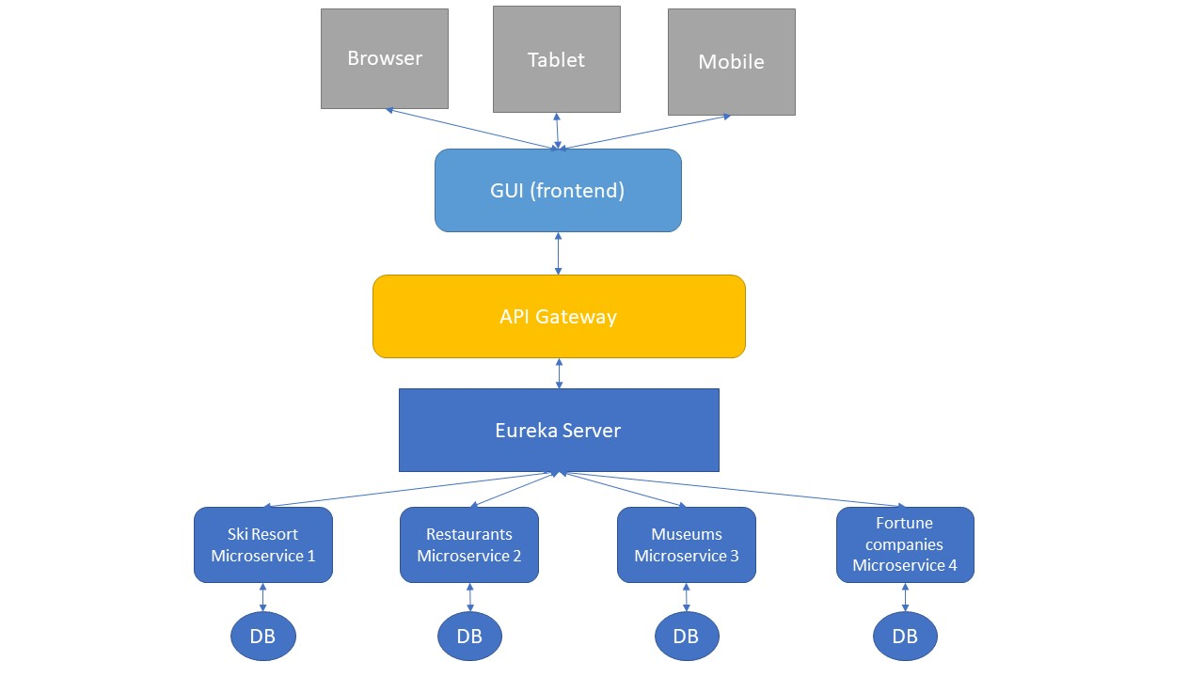
Microservice Application Configuration
Team - 01
Services Registration and Discovery
Eureka Server and Clients :3
API Gateway
SpringCloud Gateway
Requests between Services
Feign
Swagger
UI for RESTful API

